Slide 1
PLATELET MINER

Slide 2
INSTRUCTIONS FOR USE
EDIT IN GOOGLE SLIDES
Click on the button under the presentation preview that says "Use as Google Slides Theme".
You will get a copy of this document on your Google Drive and will be able to edit, add or delete slides.
You have to be signed in to your Google account.
EDIT IN POWERPOINT®
Click on the button under the presentation preview that says "Download as PowerPoint template". You will get a .pptx file that you can edit in PowerPoint.
Remember to download and install the fonts used in this presentation (you’ll find the links to the font files needed in the Presentation design slide)
More info on how to use this template at www.slidescarnival.com/help-use-presentation-template
This template is free to use under Creative Commons Attribution license. You can keep the Credits slide or mention SlidesCarnival and other resources used in a slide footer.

Slide 3

HELLO!
I am Jayden Smith
I am here because I love to give presentations.
You can find me at @username

Slide 4
1.
Pengenalan Dataset
Let’s start with the first set of slides

Slide 5
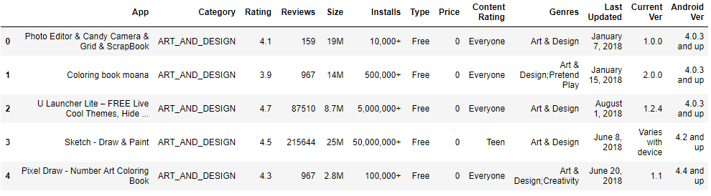
Dataset : Google Play Store
10841 x 13 Kolom
Tujuan : Prediksi rating

Slide 6
Alur Kerja
Pra-proses
Prediksi

Slide 7
Pra Proses
Menghapus data kosong
Menghilang-kan Redudansi
Hapus Kolom
Mengubah Bentuk data

Slide 8
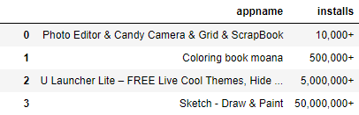
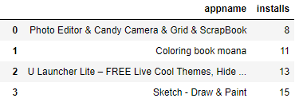
Pra-proses: mengubah bentuk data
Mengubah format
Data kate-gorikal
Menambah kolom

Slide 9
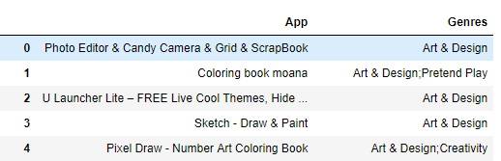
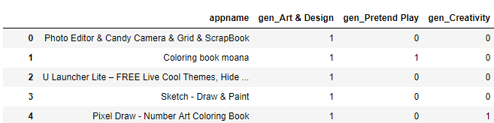
Pra Proses : Menambah Kolom
Hasil pra-proses : 8190 baris x 63 kolom

Slide 10
2.
Prediksi
Let’s start with the first set of slides

Slide 11
Modelling
Memilih metrics
Standar
-disasi
Cross-validation
Mencoba model

Slide 12

Modelling : Memilih Metrics
Metrics = ukuran bagus tidaknya performa suatu model
Mean Squared Error (MSE)
$$MSE=\left(\sum_{i=1}^{N}{{\left(y_{asli}\left[i\right]−y_{pred}\left[i\right]\right)}^{2}}\right)/N$$

Slide 13

Modelling :Standardisasi
Rumus :
$$x^{′}=\frac{x −μ}{σ}$$
dengan :
x = data asli
x' = data setelah distandarisasi
$μ$ = rata-rata data
$σ$ = standar deviasi data
Tujuan :
mengurangi pengaruh berlebih dari suatu fitur
dan membuat data berdistribusi normal

Slide 14
Contoh 4-fold
Tujuan :
Menghindari overfitting
Overfitting = performa pada data latih bagus, tapi tidak bagus pada data validasi

Slide 15
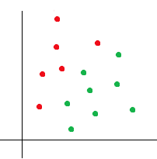
Modelling : Mencoba KNN
K-Nearest Neighbor
K = 3? hijau = 2, merah = 1
Maka bintang = hijau
K = 7? hijau = 3, merah = 4
Maka bintang = merah

Slide 16
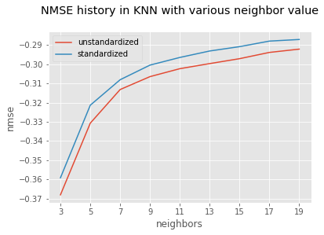
Modelling : Hasil Prediksi dengan KNN

Slide 17
Modelling : Decision Tree dan Random Forest
Genre = game?
(yes) content for everyone?
(yes) rating = 5
(no) rating = 3.7
(no) genre = shopping?
(yes) rating = 4.8
(no) rating = 2.3

Slide 18
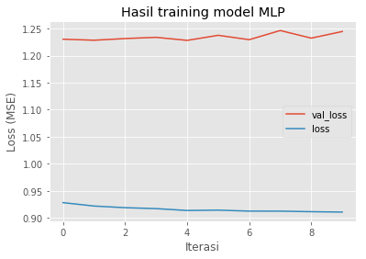
Modelling mencoba MLP

Slide 19
Model | Unstandardized | Standardized
KNN (K = 39) | 0.2872 | 0.2796
Decision Tree | 0.539 | 0.5277
Random Forest | 0.2835 | 0.2787
MLP | 1.03 | 0.91

Slide 20
Modelling : Summary
Model | Unstandardized | Standardized
KNN | 0.2872 | 0.2796
Decision Tree | 0.539 | 0.5277
Random Forest | 0.2835 | 0.2787
MLP | 1.03 | 0.91

Slide 22
Quotations are commonly printed as a means of inspiration and to invoke philosophical thoughts from the reader.

Slide 23
THIS IS A SLIDE TITLE
Here you have a list of items
And some text
But remember not to overload your slides with content
Your audience will listen to you or read the content, but won’t do both.

Slide 24
BIG CONCEPT
Bring the attention of your audience over a key concept using icons or illustrations

Slide 25
YOU CAN ALSO SPLIT YOUR CONTENT
White
Is the color of milk and fresh snow, the color produced by the combination of all the colors of the visible spectrum.
Black
Is the color of coal, ebony, and of outer space. It is the darkest color, the result of the absence of or complete absorption of light.

Slide 26
IN TWO OR THREE COLUMNS
Yellow
Is the color of gold, butter and ripe lemons. In the spectrum of visible light, yellow is found between green and orange.
Blue
Is the colour of the clear sky and the deep sea. It is located between violet and green on the optical spectrum.
Red
Is the color of blood, and because of this it has historically been associated with sacrifice, danger and courage.

Slide 27
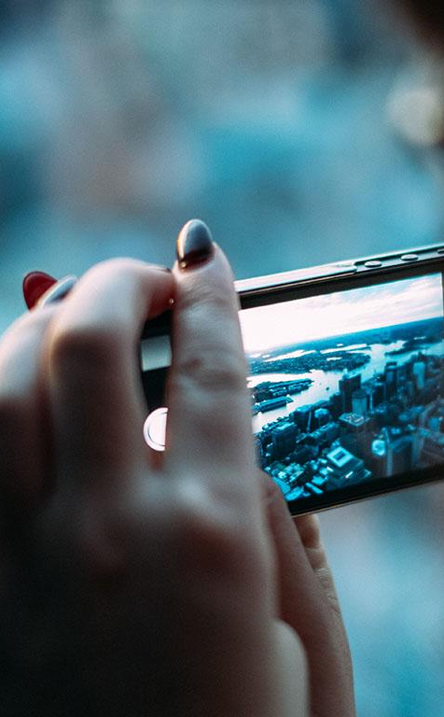
A PICTURE IS WORTH A THOUSAND WORDS
A complex idea can be conveyed with just a single still image, namely making it possible to absorb large amounts of data quickly.

Slide 28

Want big impact?
Use big image.

Slide 29
USE CHARTS TO EXPLAIN YOUR IDEAS
White
Gray
Black

Slide 30
MAPS
our office

Slide 31
89,526,124
Whoa! That’s a big number, aren’t you proud?

Slide 32
89,526,124$
185,244 users
100%
That’s a lot of money
And a lot of users
Total success!

Slide 33
LET’S REVIEW SOME CONCEPTS
Yellow
Is the color of gold, butter and ripe lemons. In the spectrum of visible light, yellow is found between green and orange.
Blue
Is the colour of the clear sky and the deep sea. It is located between violet and green on the optical spectrum.
Red
Is the color of blood, and because of this it has historically been associated with sacrifice, danger and courage.
Yellow
Is the color of gold, butter and ripe lemons. In the spectrum of visible light, yellow is found between green and orange.
Blue
Is the colour of the clear sky and the deep sea. It is located between violet and green on the optical spectrum.
Red
Is the color of blood, and because of this it has historically been associated with sacrifice, danger and courage.

Slide 34
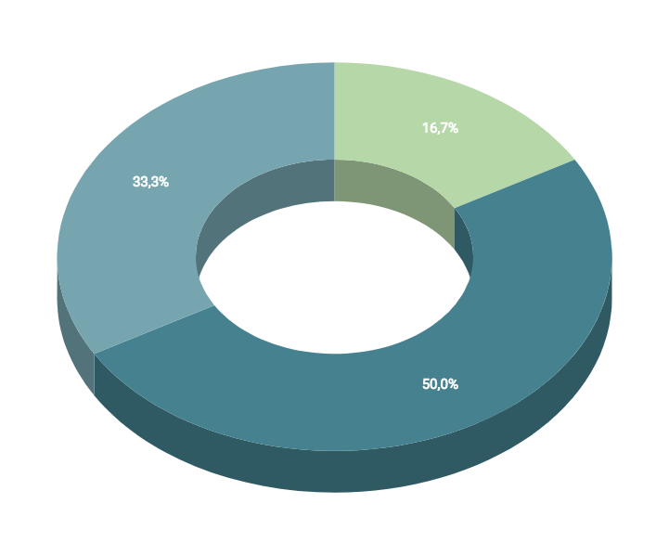
You can insert graphs from Google Sheets

Slide 35
ANDROID PROJECT
Show and explain your web, app or software projects using these gadget templates.
Place your screenshot here

Slide 36
iPHONE PROJECT
Show and explain your web, app or software projects using these gadget templates.
Place your screenshot here

Slide 37
TABLET PROJECT
Show and explain your web, app or software projects using these gadget templates.
Place your screenshot here

Slide 38
DESKTOP PROJECT
Show and explain your web, app or software projects using these gadget templates.
Place your screenshot here

Slide 39
THANKS!
Any questions?
You can find me at:
@username
user@mail.me

Slide 40
CREDITS
Special thanks to all the people who made and released these awesome resources for free:
Presentation template by SlidesCarnival
Photographs by Unsplash

Slide 41
PRESENTATION DESIGN
This presentation uses the following typographies and colors:
Titles: Dosis
Body copy: Titillium Web
You can download the fonts on these pages:
http://www.impallari.com/dosis
http://www.campivisivi.net/titillium/
Pastel green #d3ebd5 · Green #80bfb7 · Teal #0b87a1 · Navy #01597f · Dark navy #003b55
You don’t need to keep this slide in your presentation. It’s only here to serve you as a design guide if you need to create new slides or download the fonts to edit the presentation in PowerPoint®

Slide 42
SlidesCarnival icons are editable shapes.
This means that you can:
Resize them without losing quality.
Change fill color and opacity.
Change line color, width and style.
Isn’t that nice? :)
Examples:

Slide 43
😉
Now you can use any emoji as an icon!
And of course it resizes without losing quality and you can change the color.
How? Follow Google instructions https://twitter.com/googledocs/status/730087240156643328
✋👆👉👍👤👦👧👨👩👪💃🏃💑❤😂😉😋😒😭👶😸🐟🍒🍔💣📌📖🔨🎃🎈🎨🏈🏰🌏🔌🔑 and many more...

